Slide 1

Trial Lesson
Joanna Hebel
24th February 2022

Slide 2

Lesson objectives
Learn about each other
Introduction to Preply
Course focus and placement test feedback
A demo lesson
Course options
Questions

Slide 3

Get to know each other

Slide 4
Getting to know YOU
Where are you from?
Where do you _____ ?
What do you _____? / What _____ your job?
What do you _____ in your free time?
What do you hope to _____ in the future?
How long _____ you been studying English?
What do you _____ most challenging about English?
Do you _____ any other languages?
I am from _____.
I live in _____.
is find achieve speak
live do x2 have

Slide 5

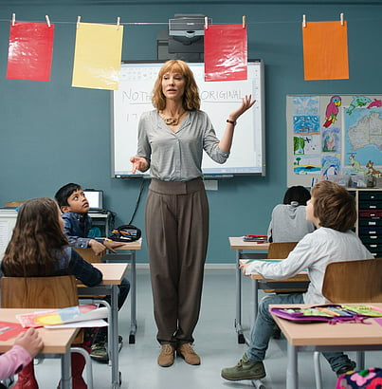


AMA – Ask Me Anything
Choose any topic you want to ask me about.
Hobbies Study Employment Family Holidays Music

Slide 6

Discussion feedback

Slide 7
The Preply classroom
Tools available on Preply classroom:
Whiteboard
Library of Resources
Flashcards
Screensharing
What I use while teaching:
Platforms – Zoom, Microsoft Teams, Skype or Preply.
Presentation – to follow the materials
Preply or Email – for communication
Preply or Email – for material sharing

Slide 8



Placement Test and Course Focus
Questions about your placement test and course:
Have you checked your results?
What do you hope to achieve by the end of the course?
What specific area of English do you want to focus on?
How do you see me helping you during the course?

Slide 9

Demo lesson
Question word order and intonation

Slide 10

Returning questions
Where are you from?
I am from India.
Where are you from?
What about you?
And you?
Where did you learn English before?
What kind of music do you listen to?
What TV programmes or series do you watch?
Do you do any sport or exercise? What?

Slide 11

Which words carry information?
Where are you from?
Where were you born?
Where do you live?
Do you live in a house or a flat?
Do you have any brothers and sisters?
Do you have any pets?

Slide 12
Word order in questions
Do you have any pets?
Where are you from?
Question word | Auxiliary verb | Subject | verb | …?
 | Do | you | have | any pets?
Where | are | you |  | from?

Slide 13
Correct and discuss the questions
Can you play a musical instrument?
Where works your father?
Were you at this school last year?
Is there a supermarket near hear?
Have you cereal for breakfast?
Where went you for your last holiday?
1.
2.
3.
4.
5.
6.

Slide 14

Lesson feedback
What did you think of the lesson?
How did you find the different activities?
What did you learn today?
What would you like to focus on in our next lesson?

Slide 15

Course discussion
How often do you hope to have lessons each week?
What do you hope to focus on (business, general conversation, etc.)?
How much homework do you plan to complete outside of online lessons?
Any other questions?

